Slide 1

Predicting Steam Reviews
An analysis of the positive and negative review totals of the games on the Steam digital gaming platform

Slide 2
Popularity of Gaming
Video games have become a highly lucrative enterprise in recent decades as their overall popularity has continuously improved – they are no longer a solely “geeky” pursuit, but now have gained some of the level of prestige shared with professional sports
In order to excel in the video game market, publishers must achieve the best balance between the popularity of their products and the associated cost – much of this popularity is driven by positive reviews by players, and can be harmed by negative ones
This project seeks to predict what the likely total number of positive and negative reviews a game will receive based on its other statistics found in the Steam digital gaming platform

Slide 3
Data Source
The data used for this project was obtained through the SteamSpy website’s API (https://steamspy.com/api.php) by using the Python application to create files for the pulled data sets
The training data is from the data pulled on July 2nd, 2020
The testing data is from the data pulled on July 13th, 2020, through July 18th, 2020, inclusive
Five predictor variables were used in the models: overall median play time of the game by all owners, the game’s publisher, the standard price of the game, any discounts applied to the price of the game at the time that the data was pulled, and number of owners of the game as broken up into specific range groups
The variables to be predicted were the total number of positive and negative reviews received by each game

Slide 4
Training Models
Fifteen different training models were used for comparison to one another and to mitigate possible biases in the process
Ten of these models were linear regression models split evenly between both the positive and negative review totals predictions and were based on differing levels of interaction between predictors: no intervariable interactions; interaction between the publishers and the number of owners; interaction between the base price and the discount; interaction between the number of owners and the median play time; interactions between the publishers, the number of owners, and the median play time (both combined as three different pairwise combinations and one of all three together)
While attempts were made to perform the same number of Poisson regression models, five of that type of model which were attempted resulted in divergent results and failed to produce viable models – the remaining five models consisted of four models for positive reviews based on no interaction, interaction between the publishers and the number of owners, interaction between the base price and the discount, and interaction between the number of owners and the median play time; and one model for negative reviews based on interaction between the number of owners and the median play time

Slide 5
Training Model Results
The resulting effects of the values and factors of the predictors in the linear regression models showed strong levels of statistical significance while maintaining estimated values which were not widely varied from one another
The amount of standard error for each coefficient, however, did show much higher levels of variability, especially in those models which included interaction terms between the publishers, the number of owners, and the median play time
These differences can be seen in the following plot snippets for the associated positive review models

Slide 6
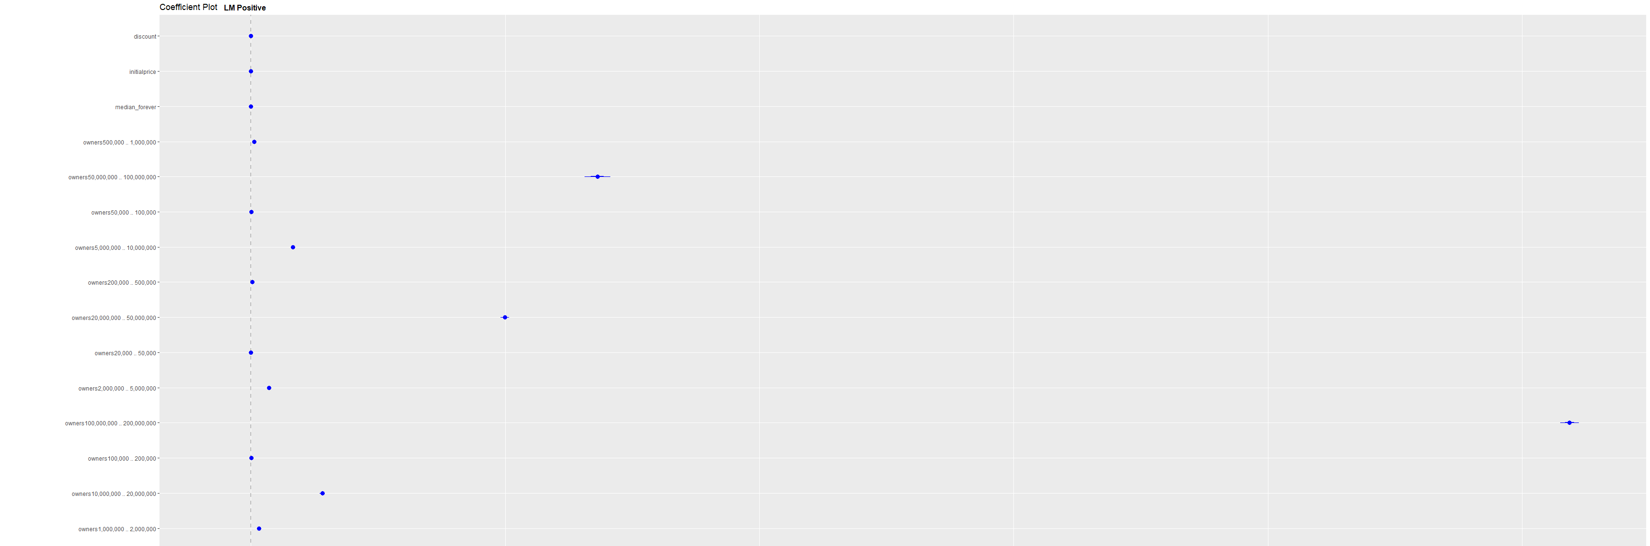
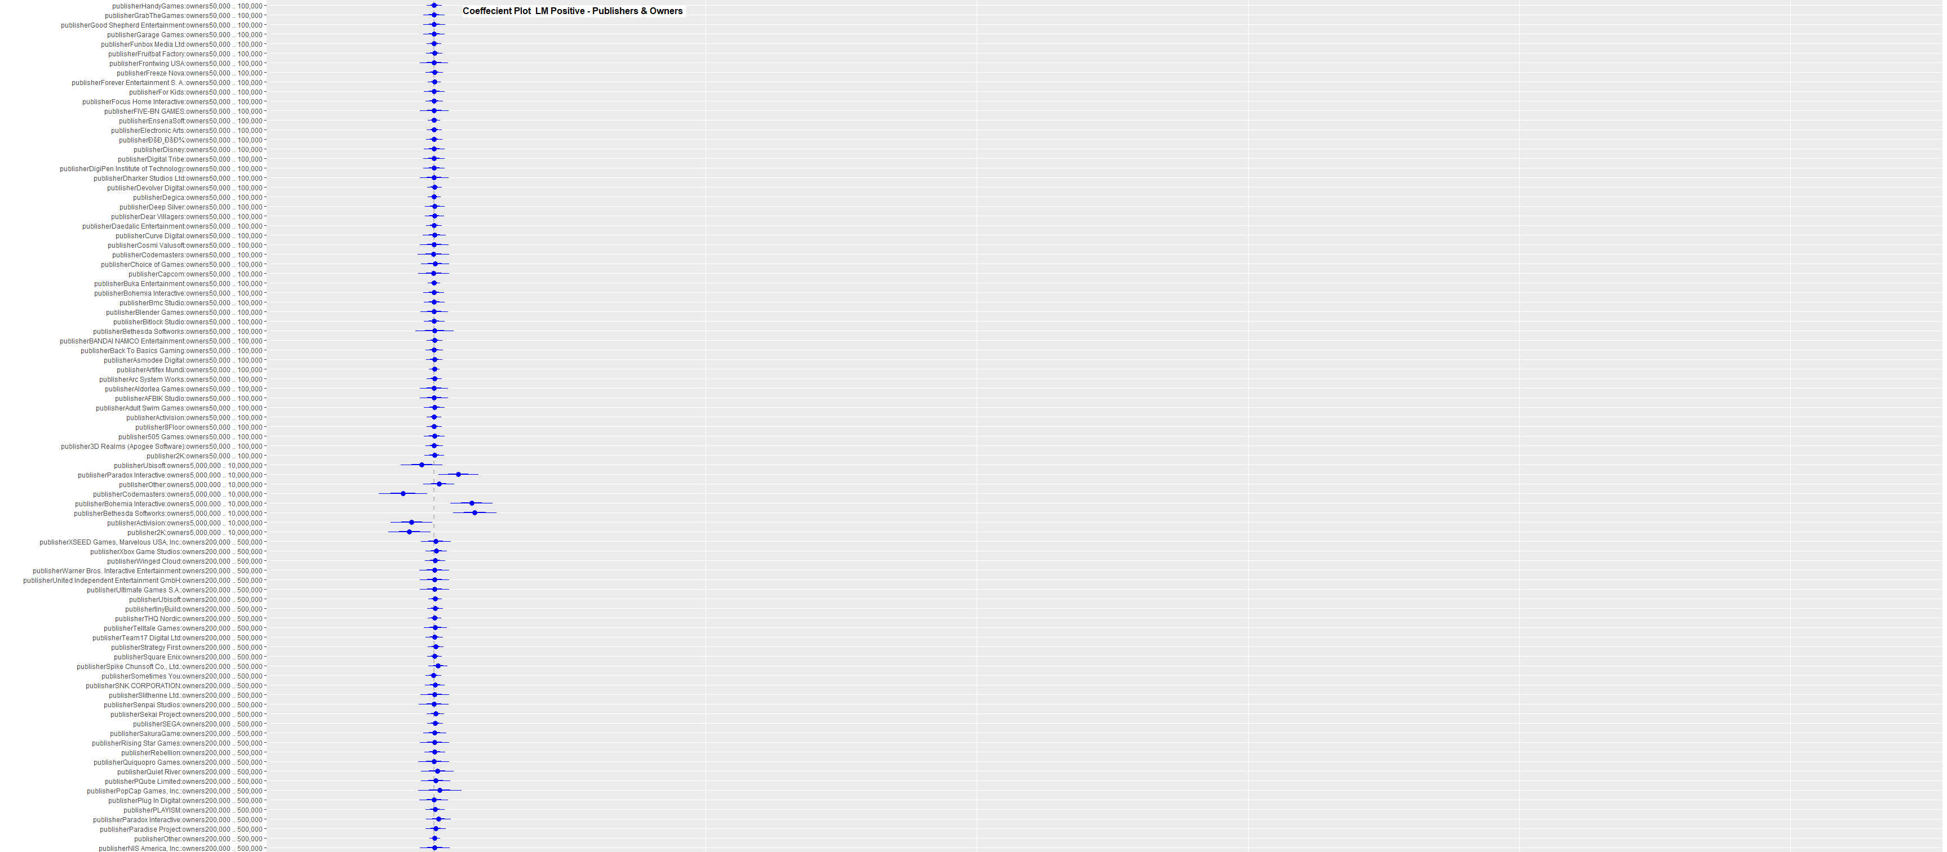
Linear Regression Model – Positive Reviews – No Interactions
Linear Regression Model – Positive Reviews – Publishers & Owners

Slide 7
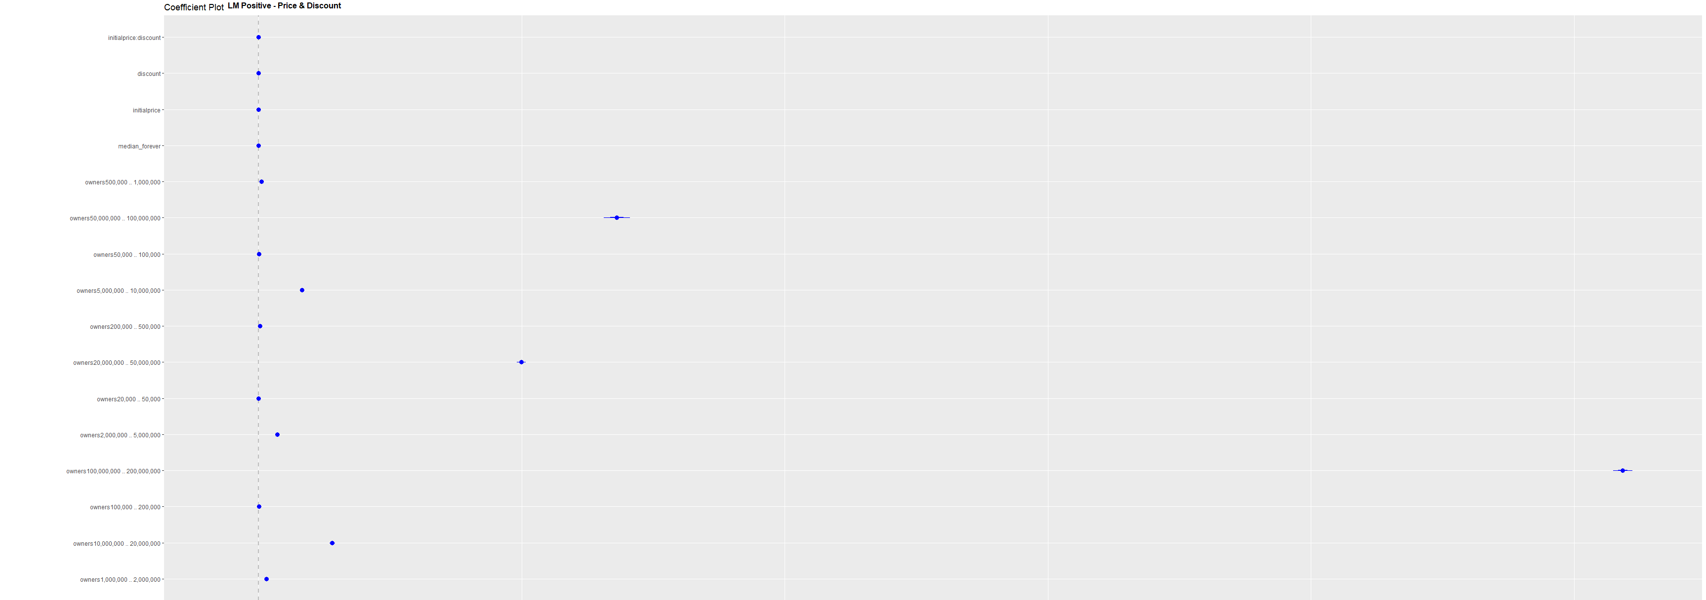
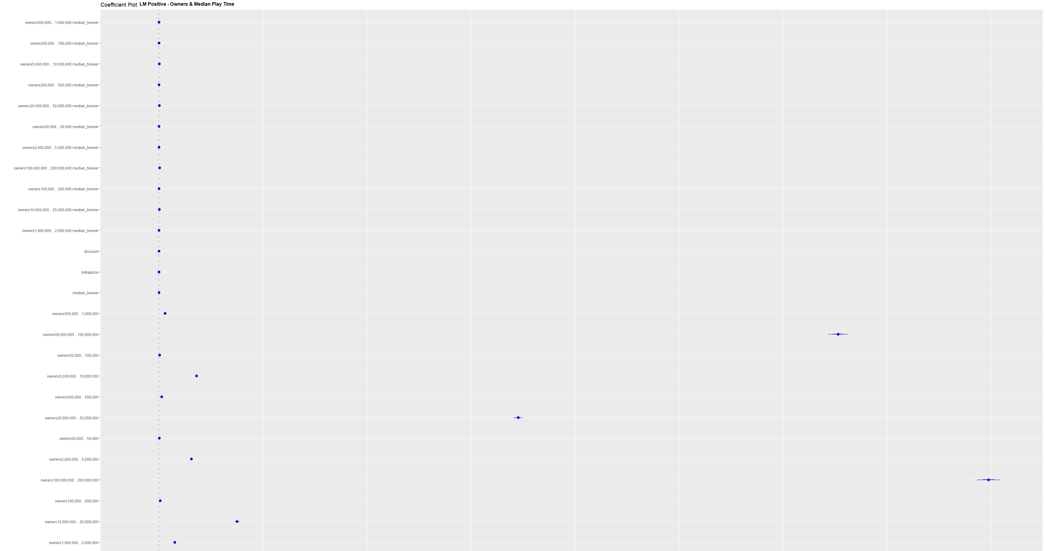
Linear Regression Model – Positive Reviews – Price & Discount
Linear Regression Model – Positive Reviews – Owners & Median Play Time

Slide 8
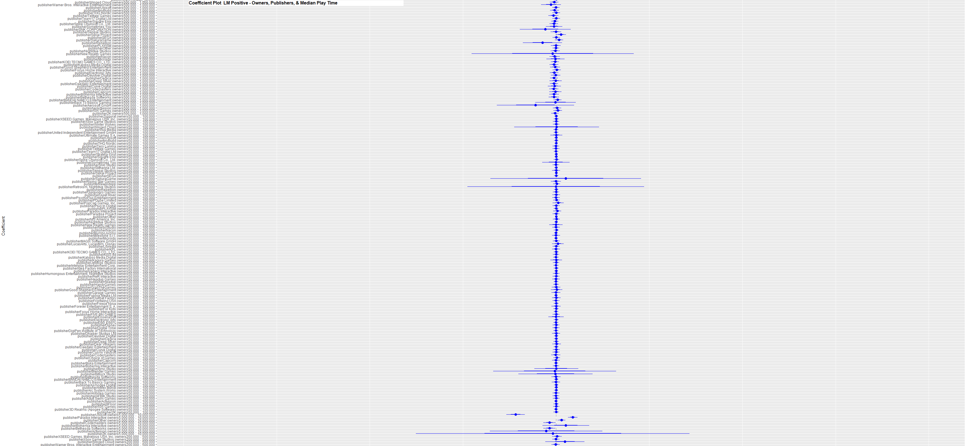
Linear Regression Model – Positive Reviews – Publishers, Owners, & Median Play Time

Slide 9
Training Model Results (cont.)
The results of the Poisson regression models were more ambiguous than those of the linear regression models – the coefficients for each model were very similar in the amount of standard error confidence interval to the linear regression models, but the variety in the actual values of the coefficients varied widely in comparison
The goodness of fit for the linear regression models is fairly strong for the first models without any interactions and grow increasingly more accurate as more interactions are introduced – the Poisson regression models did not have any strong indicators one way or another

Slide 10
Testing Model Results & Analysis
Upon applying the testing data to the models and reviewing the results, the residuals (the difference between the predicted line and the true results) were found to vary beyond expectations, which can be observed in the plots on the next slide

Slide 11
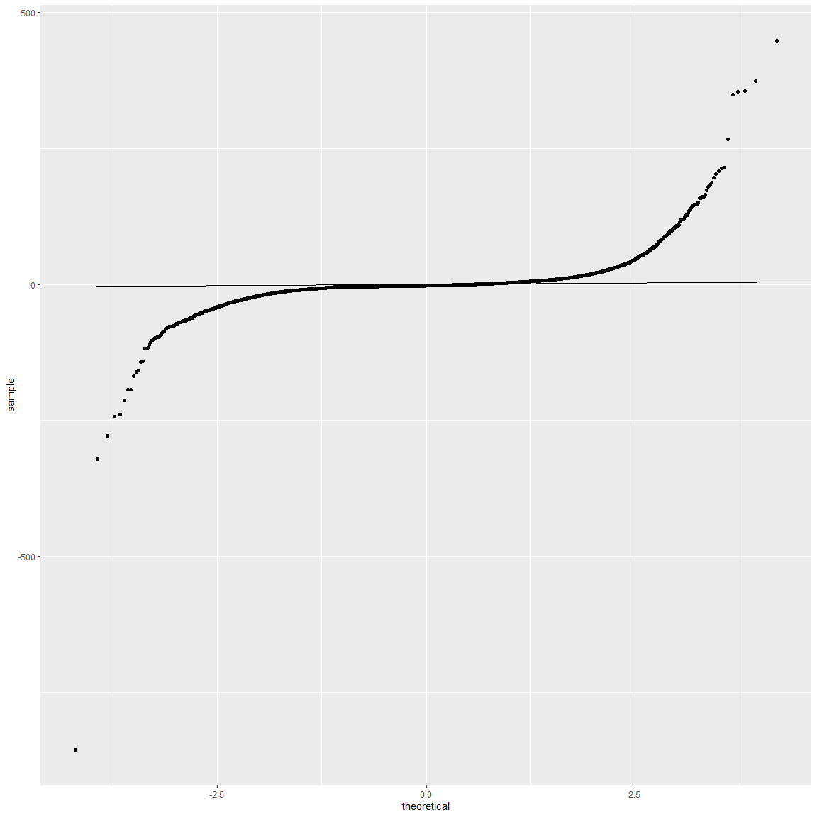
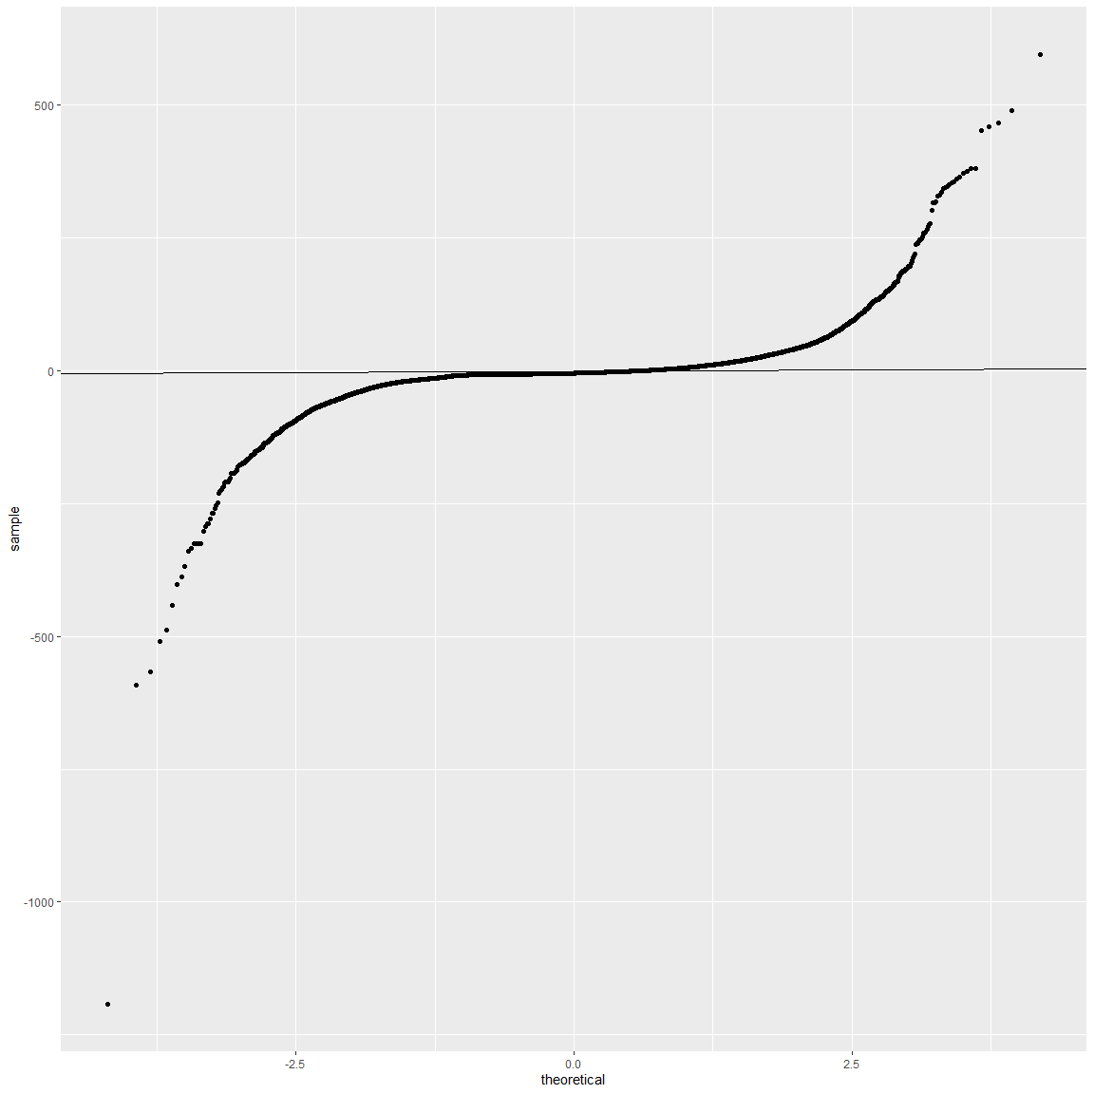
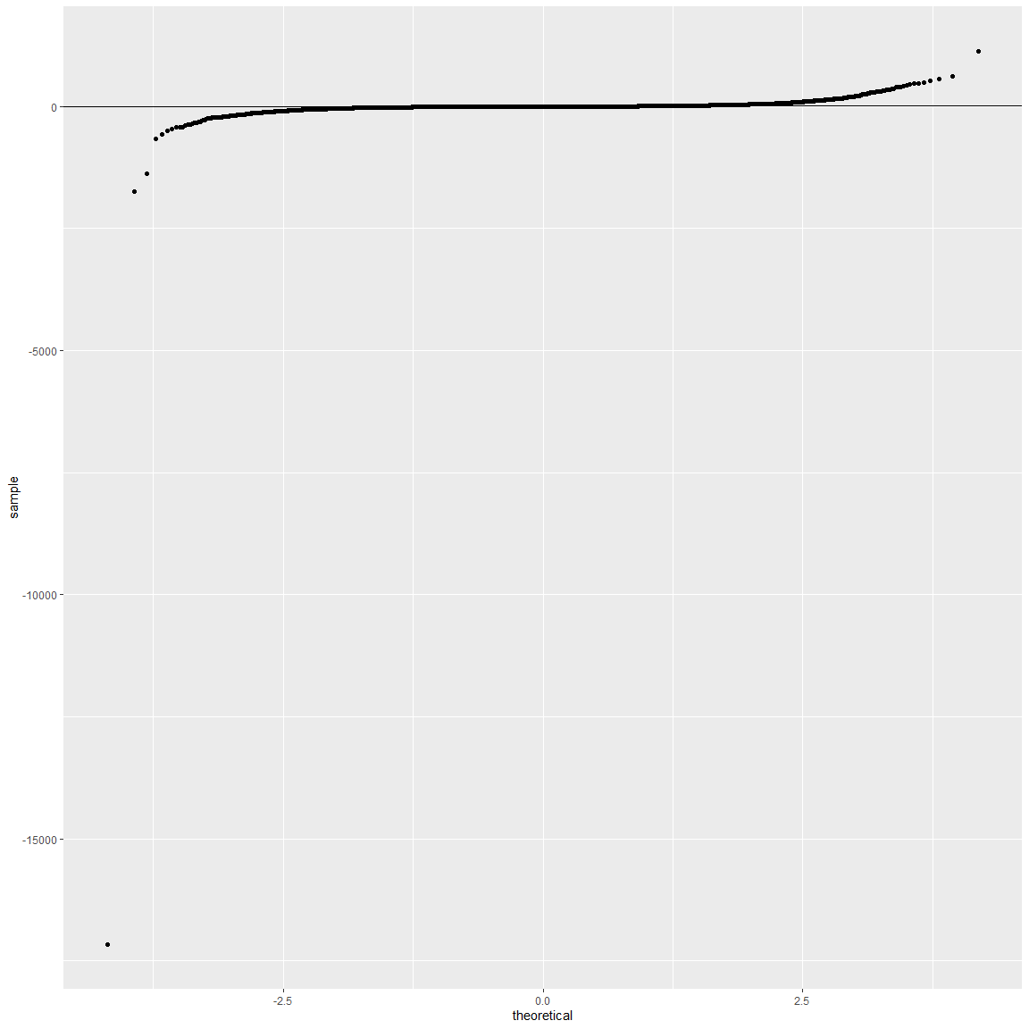
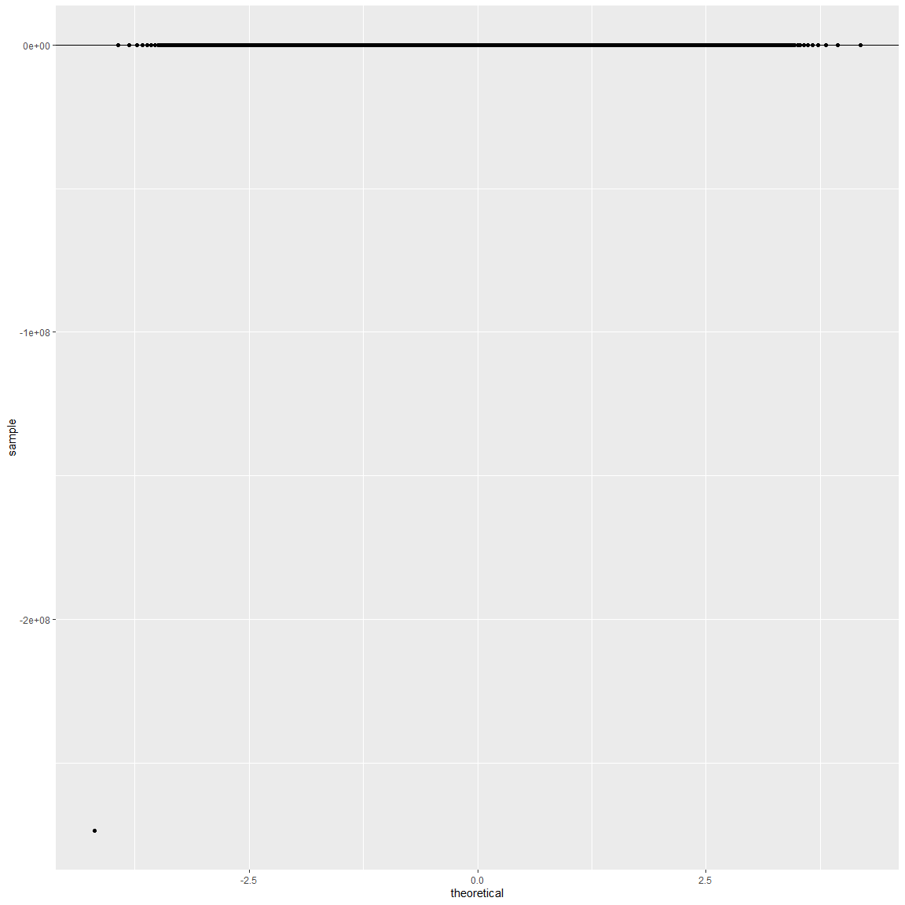
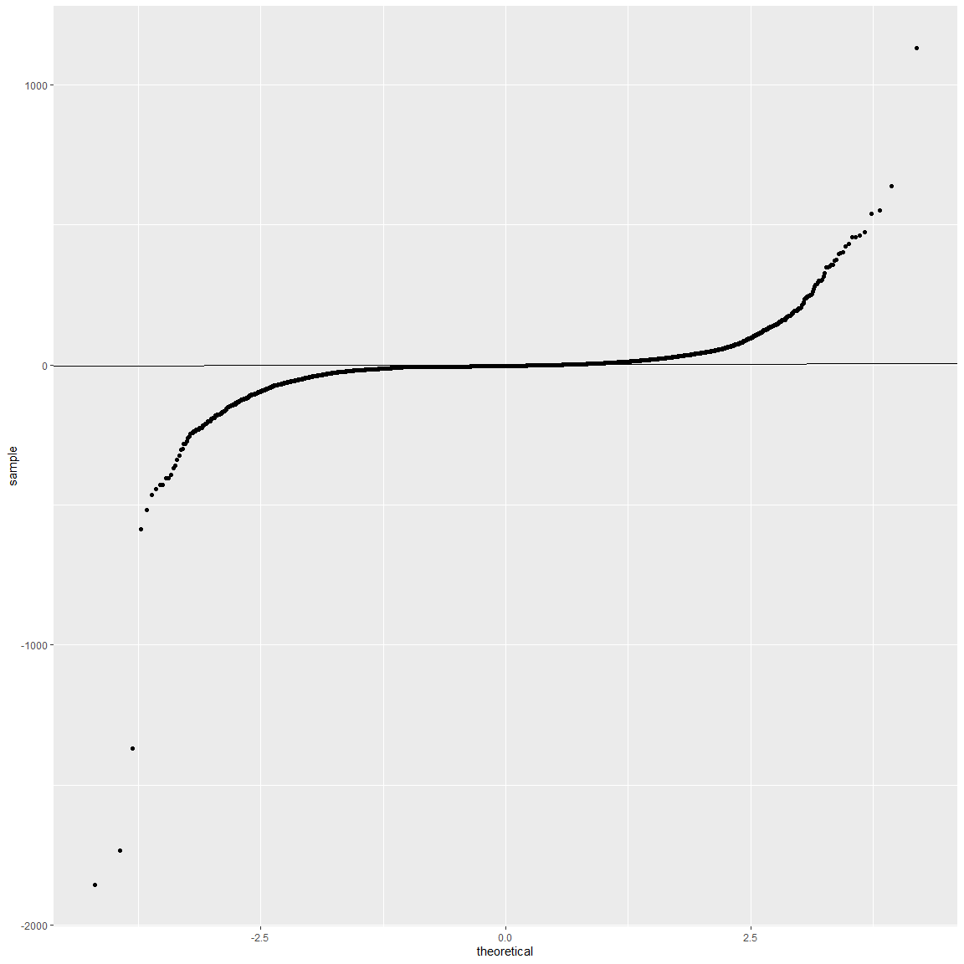
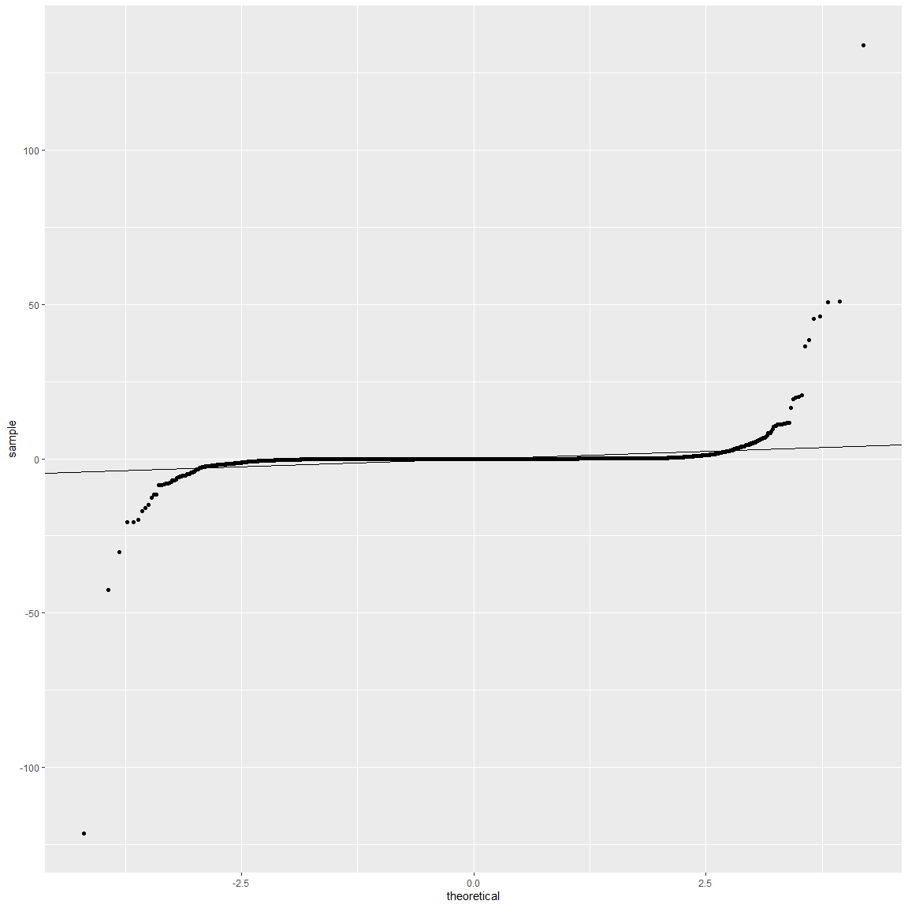
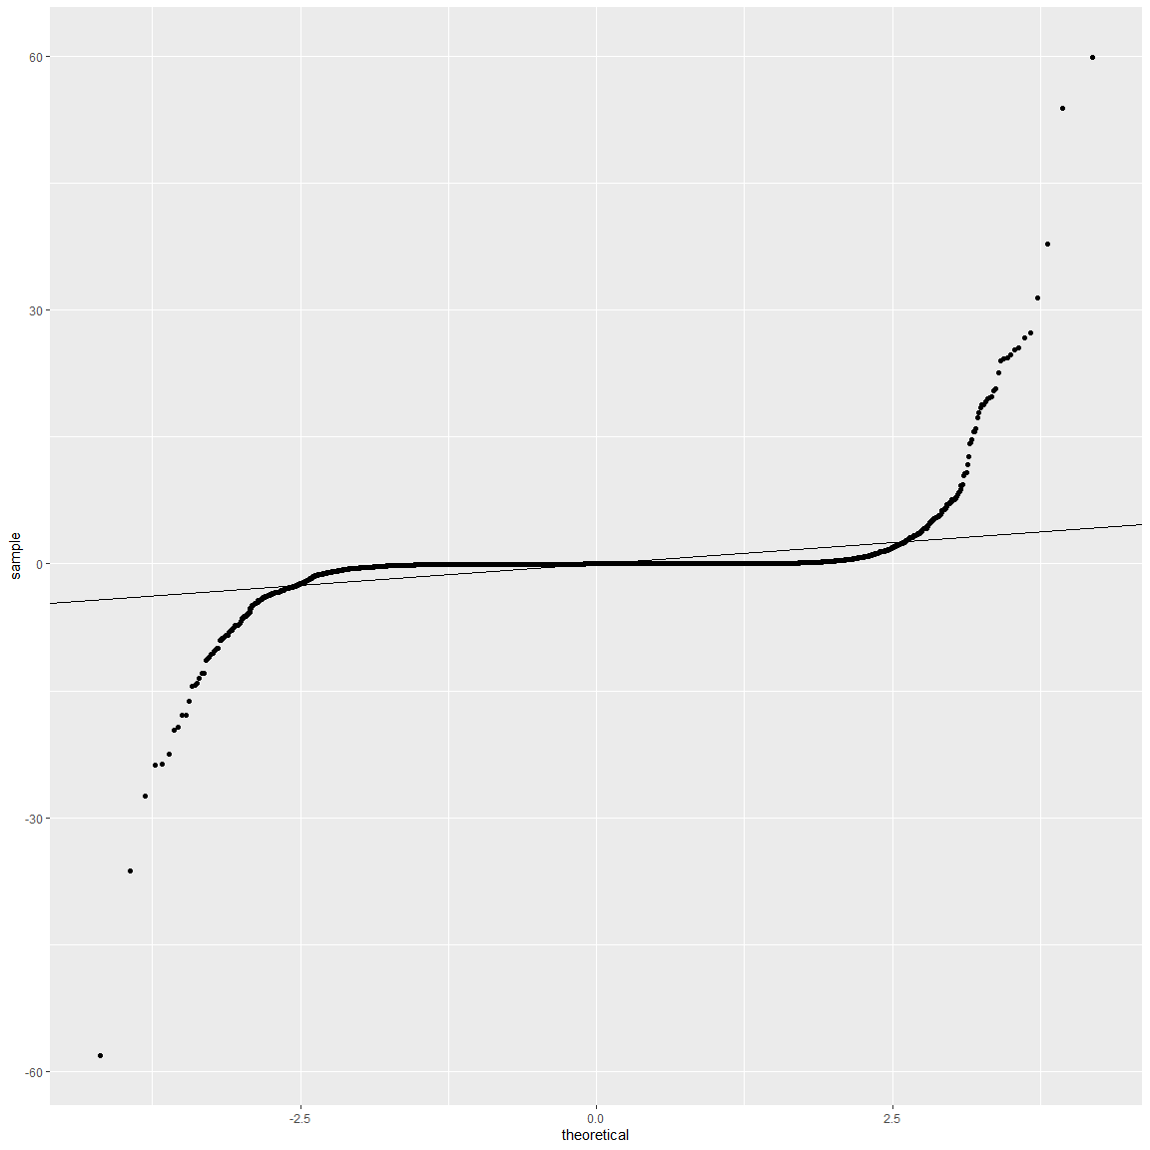
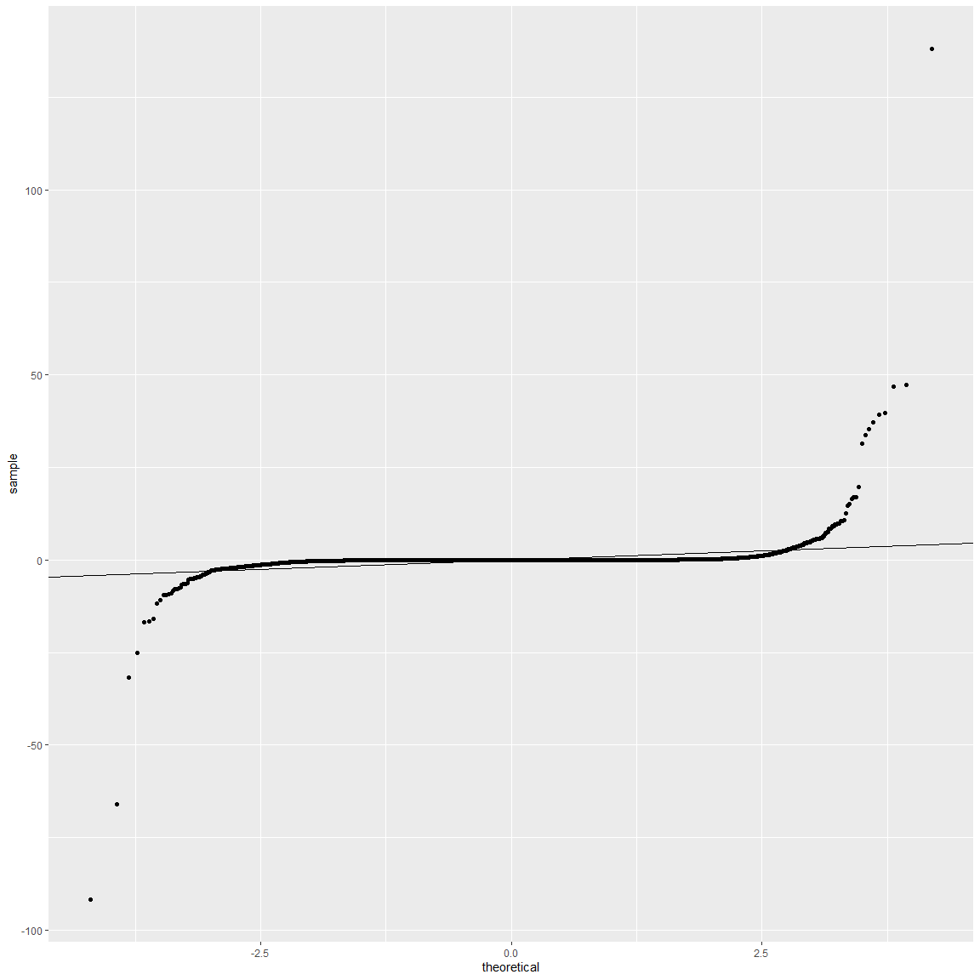
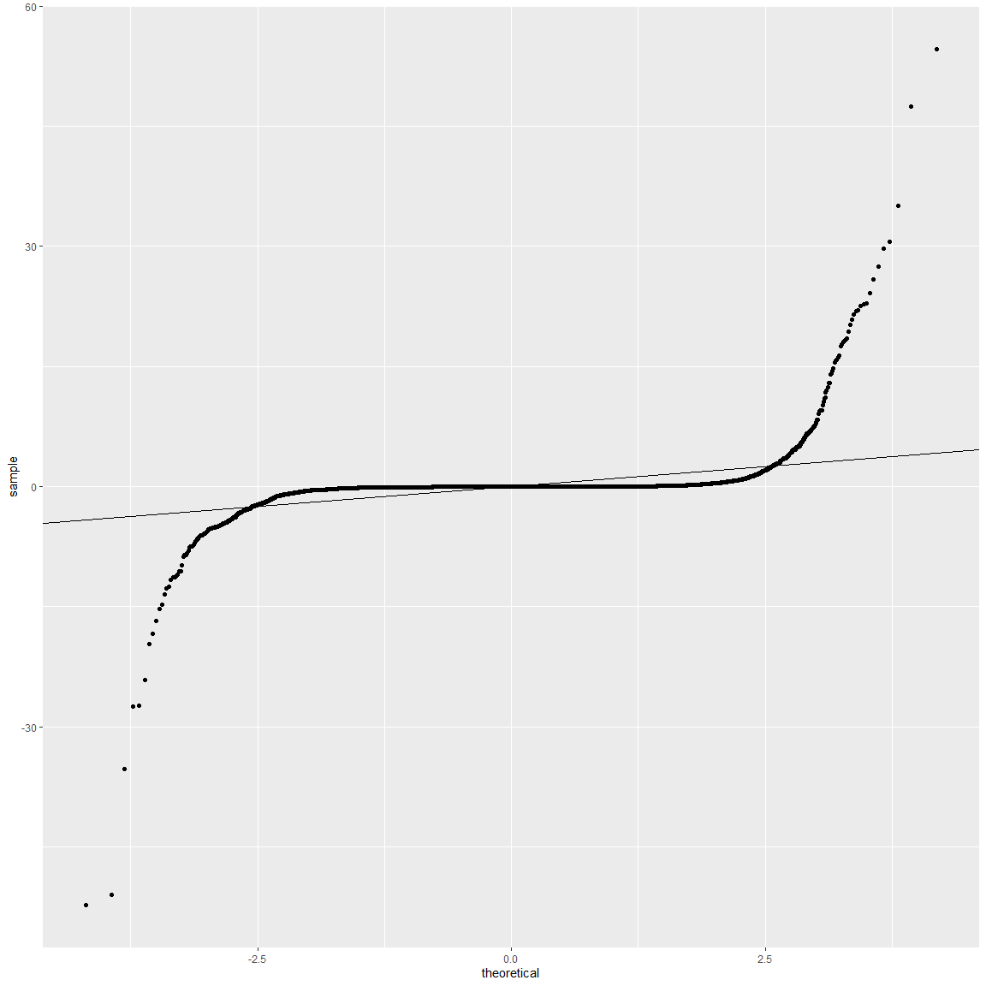
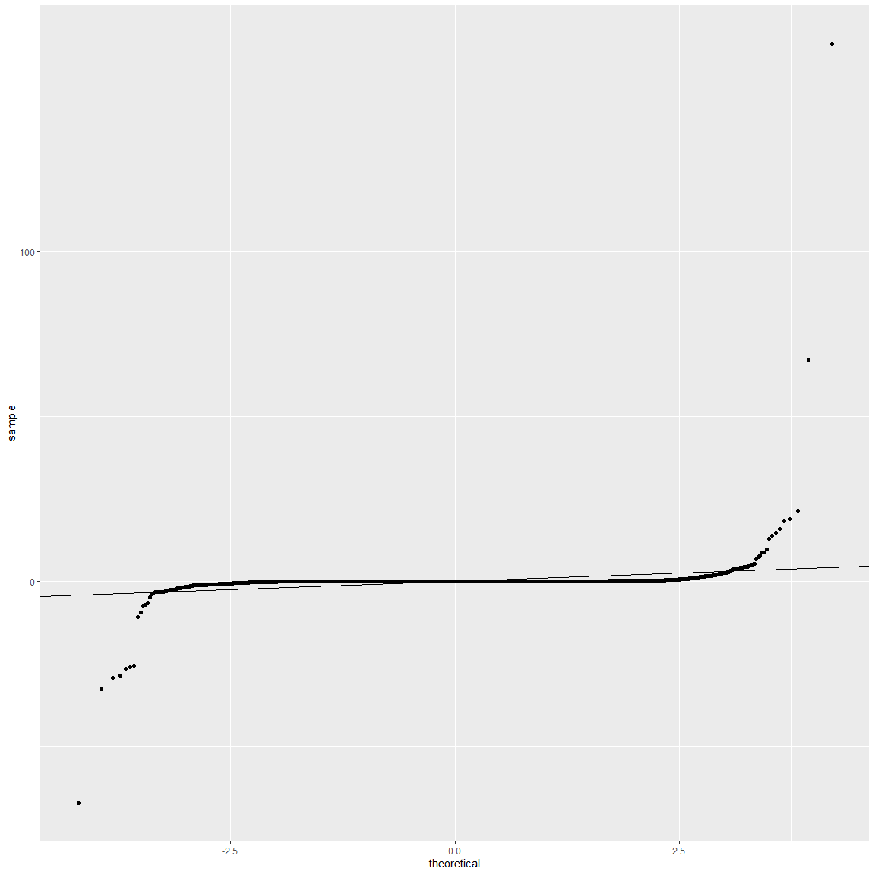
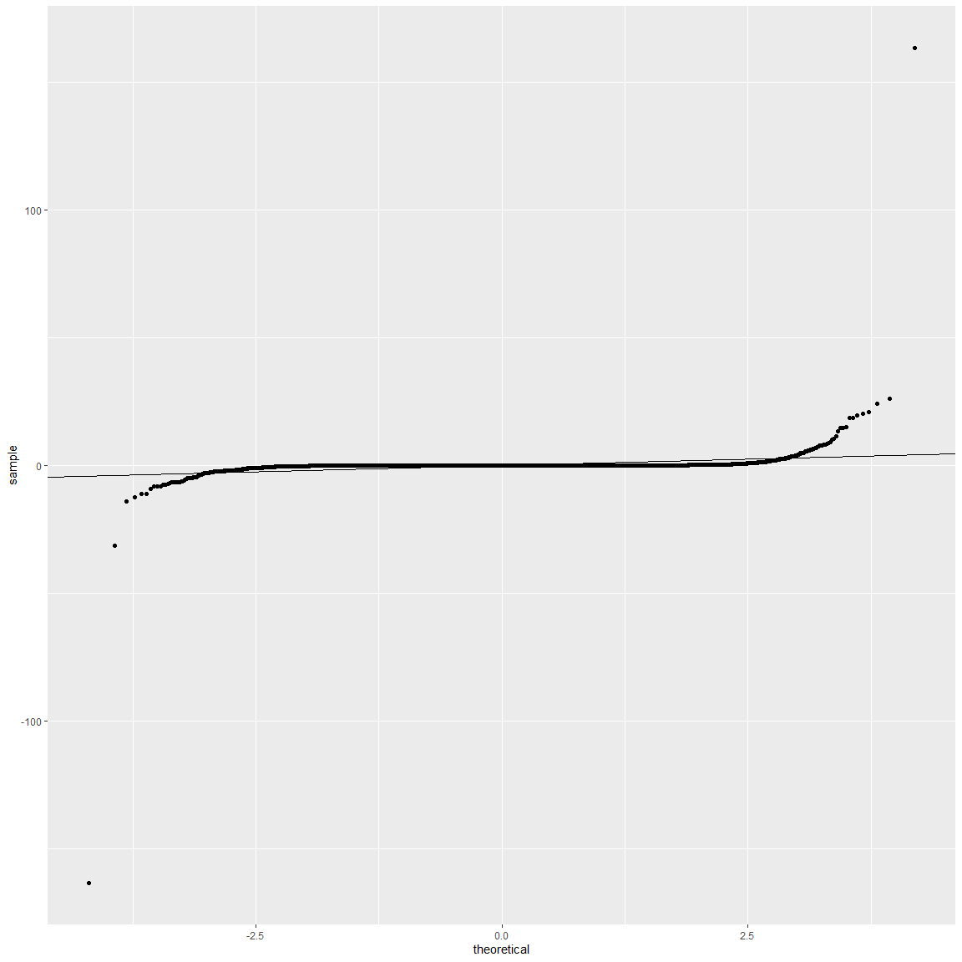
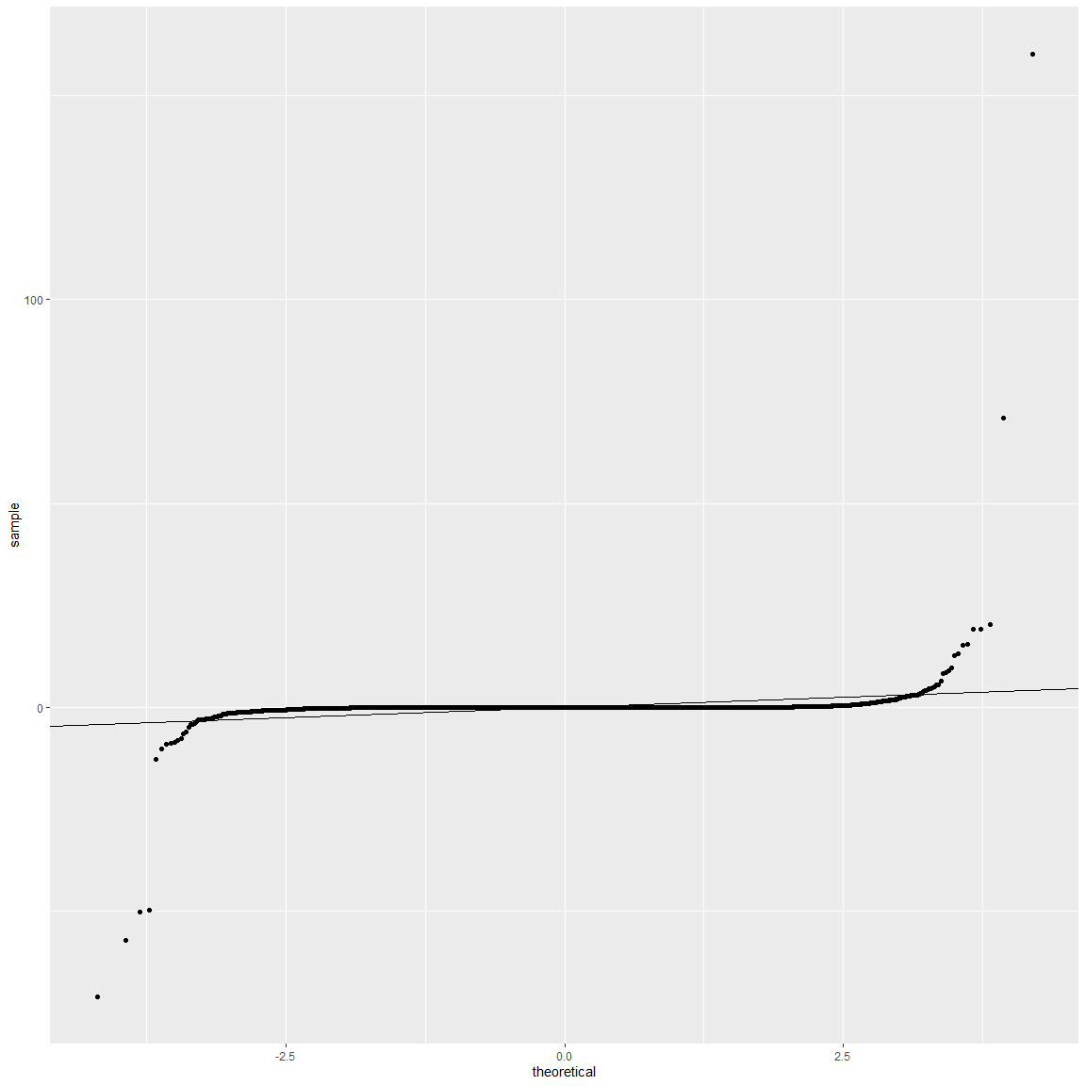




Slide 12
Conclusions
Although the initial statistical and numeric values suggested a very good fit for each of the models, when the trained models were tested the results showed significant discrepancies between the true values and the predicted ones – further evaluation of additional model options and review of the data will be required

